Slide 1
Simple Java I/O
Serialization

Slide 2
Serialization
You can also read and write objects to files
Object I/O goes by the name of serialization
Serialization in other languages can be very difficult, because objects may contain references to other objects
Java makes serialization (almost) easy

Slide 3
Conditions for serializability
If an object is to be serialized:
The class must be declared as public
The class must implement Serializable
The class must have a no-argument constructor
All fields of the class must be serializable: either primitive types or serializable objects

Slide 4
Implementing the Serializable interface
To “implement” an interface means to define all the methods declared by that interface, but...
The Serializable interface does not define any methods!
Question: What possible use is there for an interface that does not declare any methods?
Answer: Serializable is used as flag to tell Java it needs to do extra work with this class

Slide 5
Object Serialization
To read an entire object from or write an entire object to a file, Java provides object serialization.
A serialized object is represented as a sequence of bytes that includes the object’s data and its type information.
After a serialized object has been written into a file, it can be read from the file and deserialized to recreate the object in memory.

Slide 6
Object Serialization (cont.)
Classes ObjectInputStream and ObjectOutputStream, which respectively implement the ObjectInput and ObjectOutput interfaces, enable entire objects to be read from or written to a stream.
To use serialization with files, initialize ObjectInputStream and ObjectOutputStream objects with FileInputStream and FileOutputStream objects.

Slide 7
Object Serialization (cont.)
ObjectOutput interface method writeObject takes an Object as an argument and writes its information to an OutputStream.
A class that implements ObjectOuput (such as ObjectOutputStream) declares this method and ensures that the object being output implements Serializable.
ObjectInput interface method readObject reads and returns a reference to an Object from an InputStream.
After an object has been read, its reference can be cast to the object’s actual type.

Slide 8
Creating a Sequential-Access File Using Object Serialization
Objects of classes that implement interface Serializable can be serialized and deserialized with ObjectOutputStreams and ObjectInputStreams.
.
A class that implements Serializable is tagged as being a Serializable object.
An ObjectOutputStream will not output an object unless it is a Serializable object.

Slide 9
Writing objects to a file
ObjectOutputStream objectOut = new ObjectOutputStream( new FileOutputStream(fileName,true));
objectOut.writeObject(serializableObject);
objectOut.close( );

Slide 10
Reading objects from a file
ObjectInputStream objectIn = new ObjectInputStream( new FileInputStream(fileName)));
myObject = (itsType)objectIn.readObject( );
objectIn.close( );

Slide 11
Reading objects back is almost as easy. The one catch is that at runtime, you can never be completely sure what type of data to expect. A data stream containing serialized objects may contain a mixture of different object classes, so you need to explicitly cast an object to a particular class. If you've never cast an object before, the procedure is relatively straightforward. First check the object's class, using the instanceof operator. Then cast to the correct class.
// Read from disk using FileInputStream FileInputStream f_in = new FileInputStream("myobject.data"); // Read object using ObjectInputStream ObjectInputStream obj_in = new ObjectInputStream (f_in); // Read an object Object obj = obj_in.readObject(); if (obj instanceof Vector) { // Cast object to a Vector Vector vec = (Vector) obj; // Do something with vector.... }

Slide 12
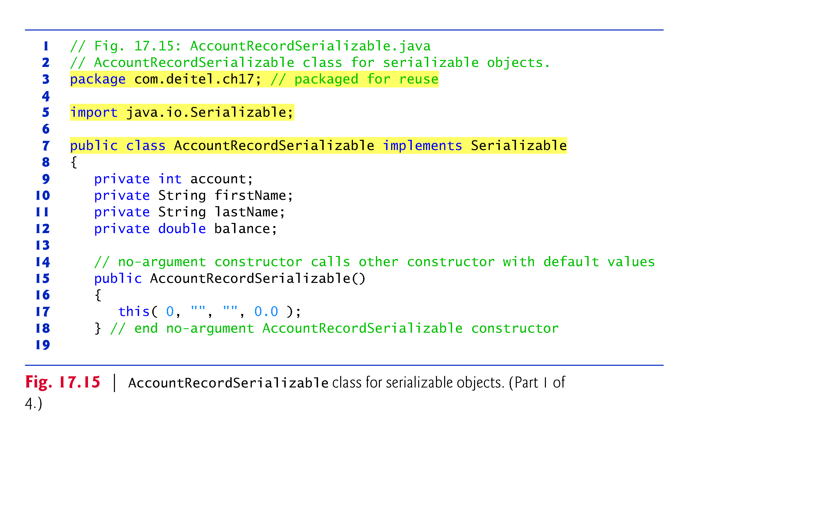

Slide 13
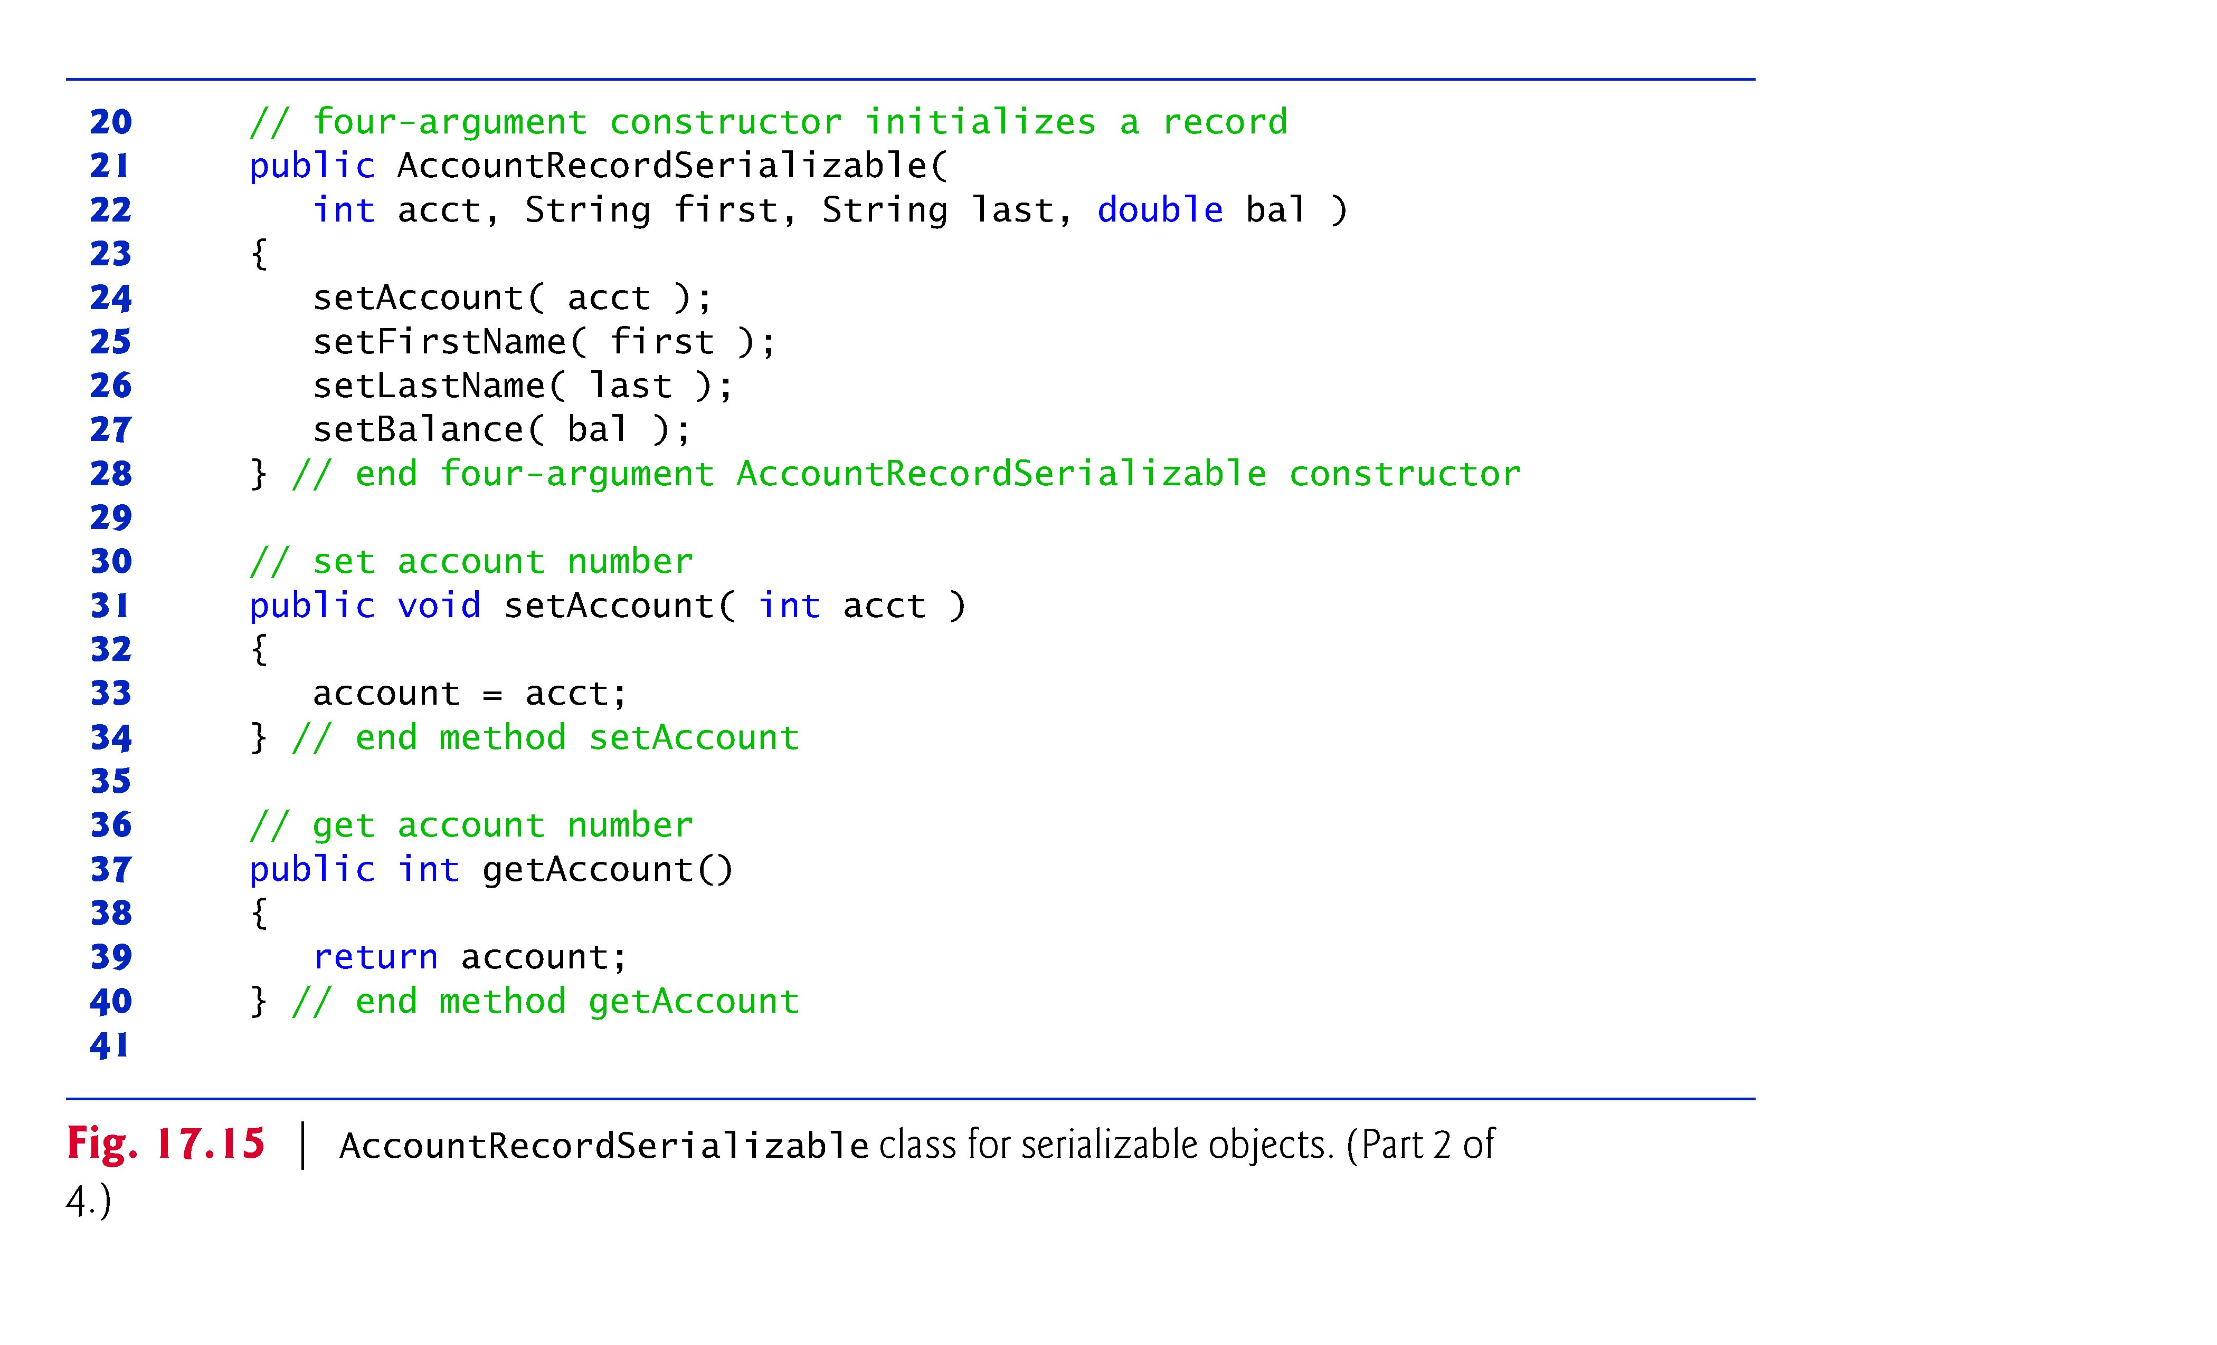

Slide 14
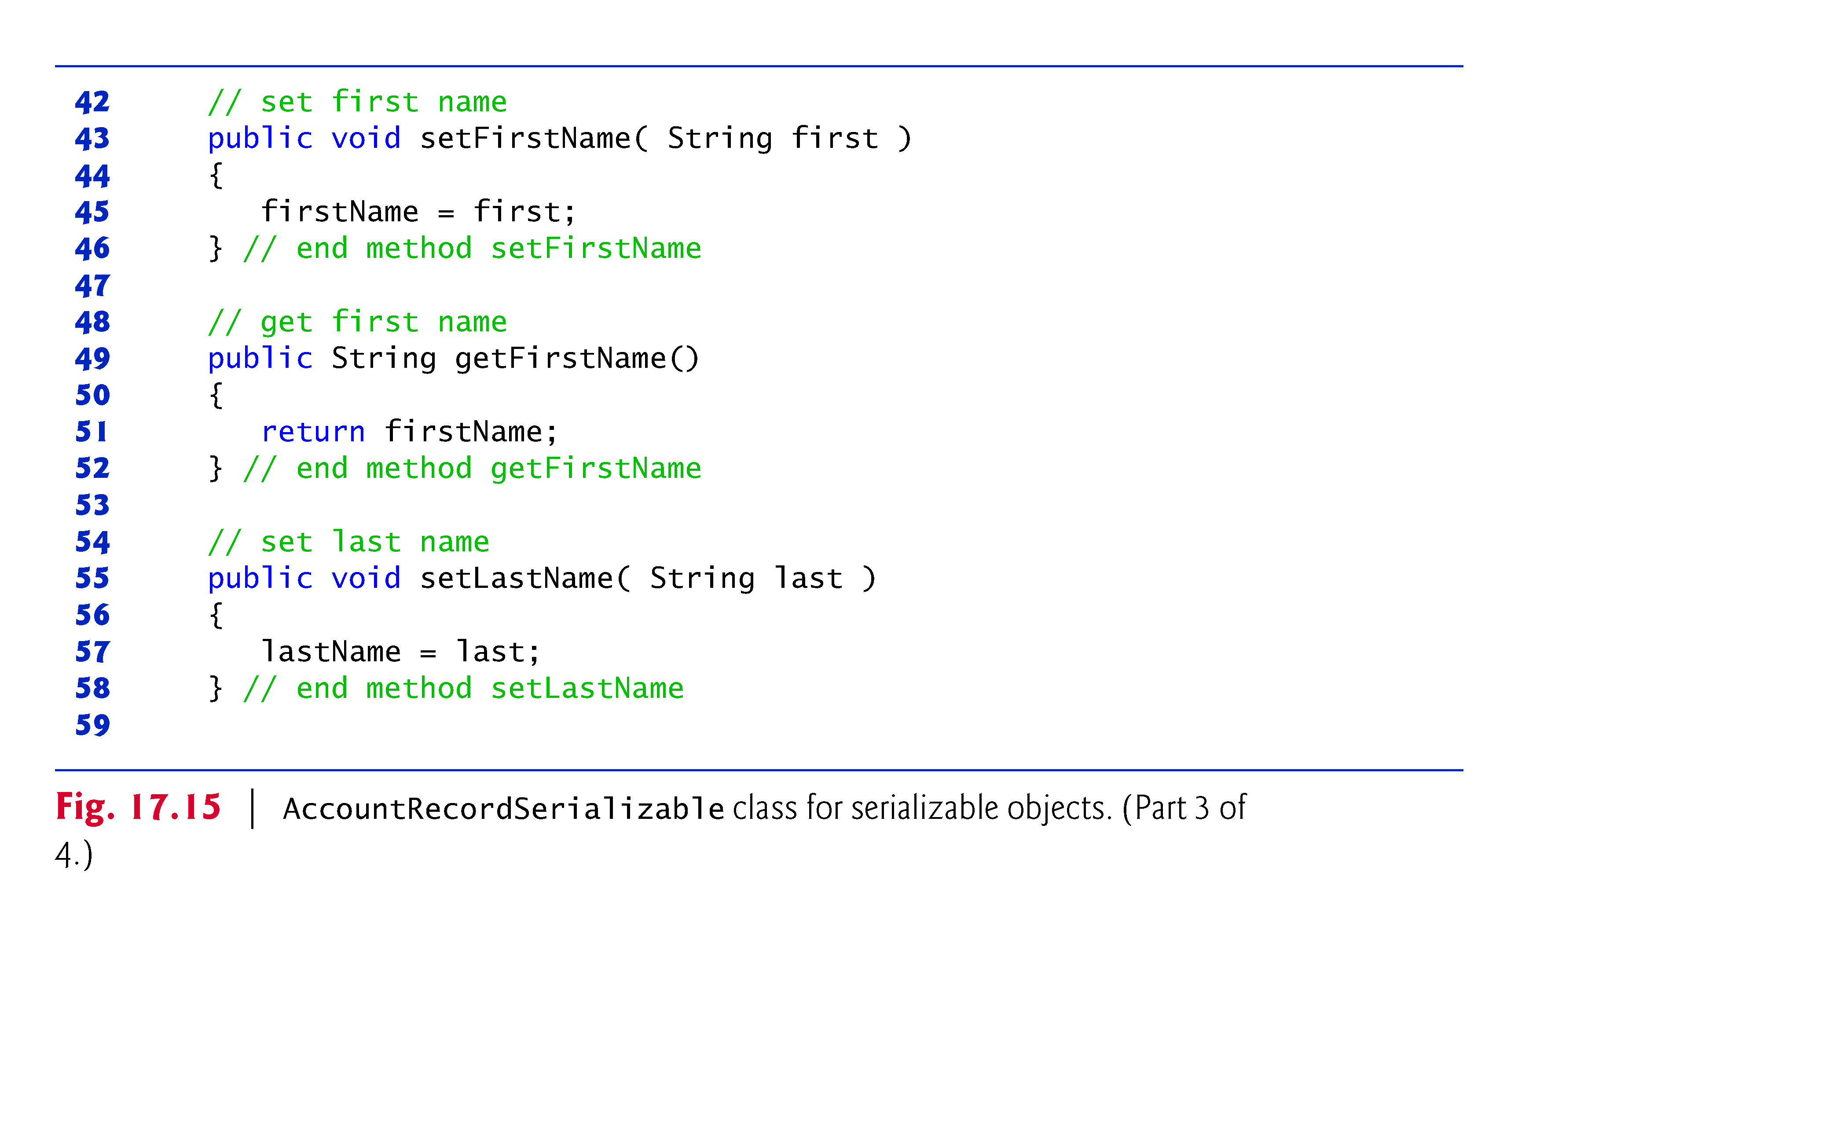

Slide 15
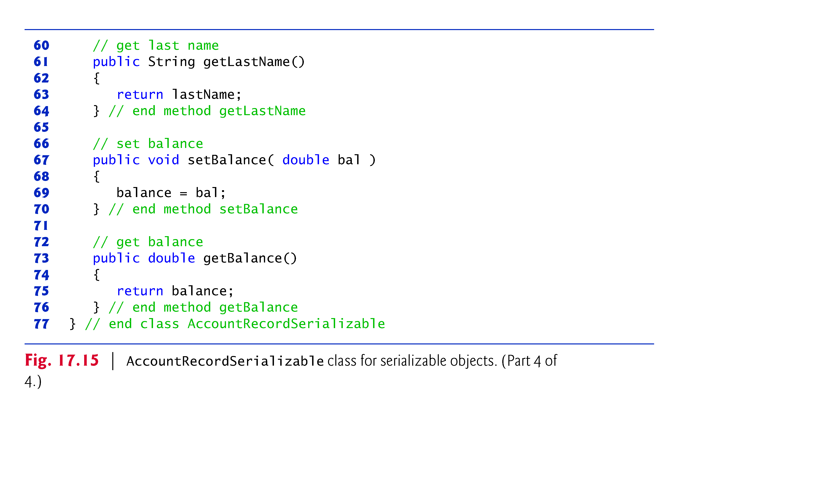

Slide 16
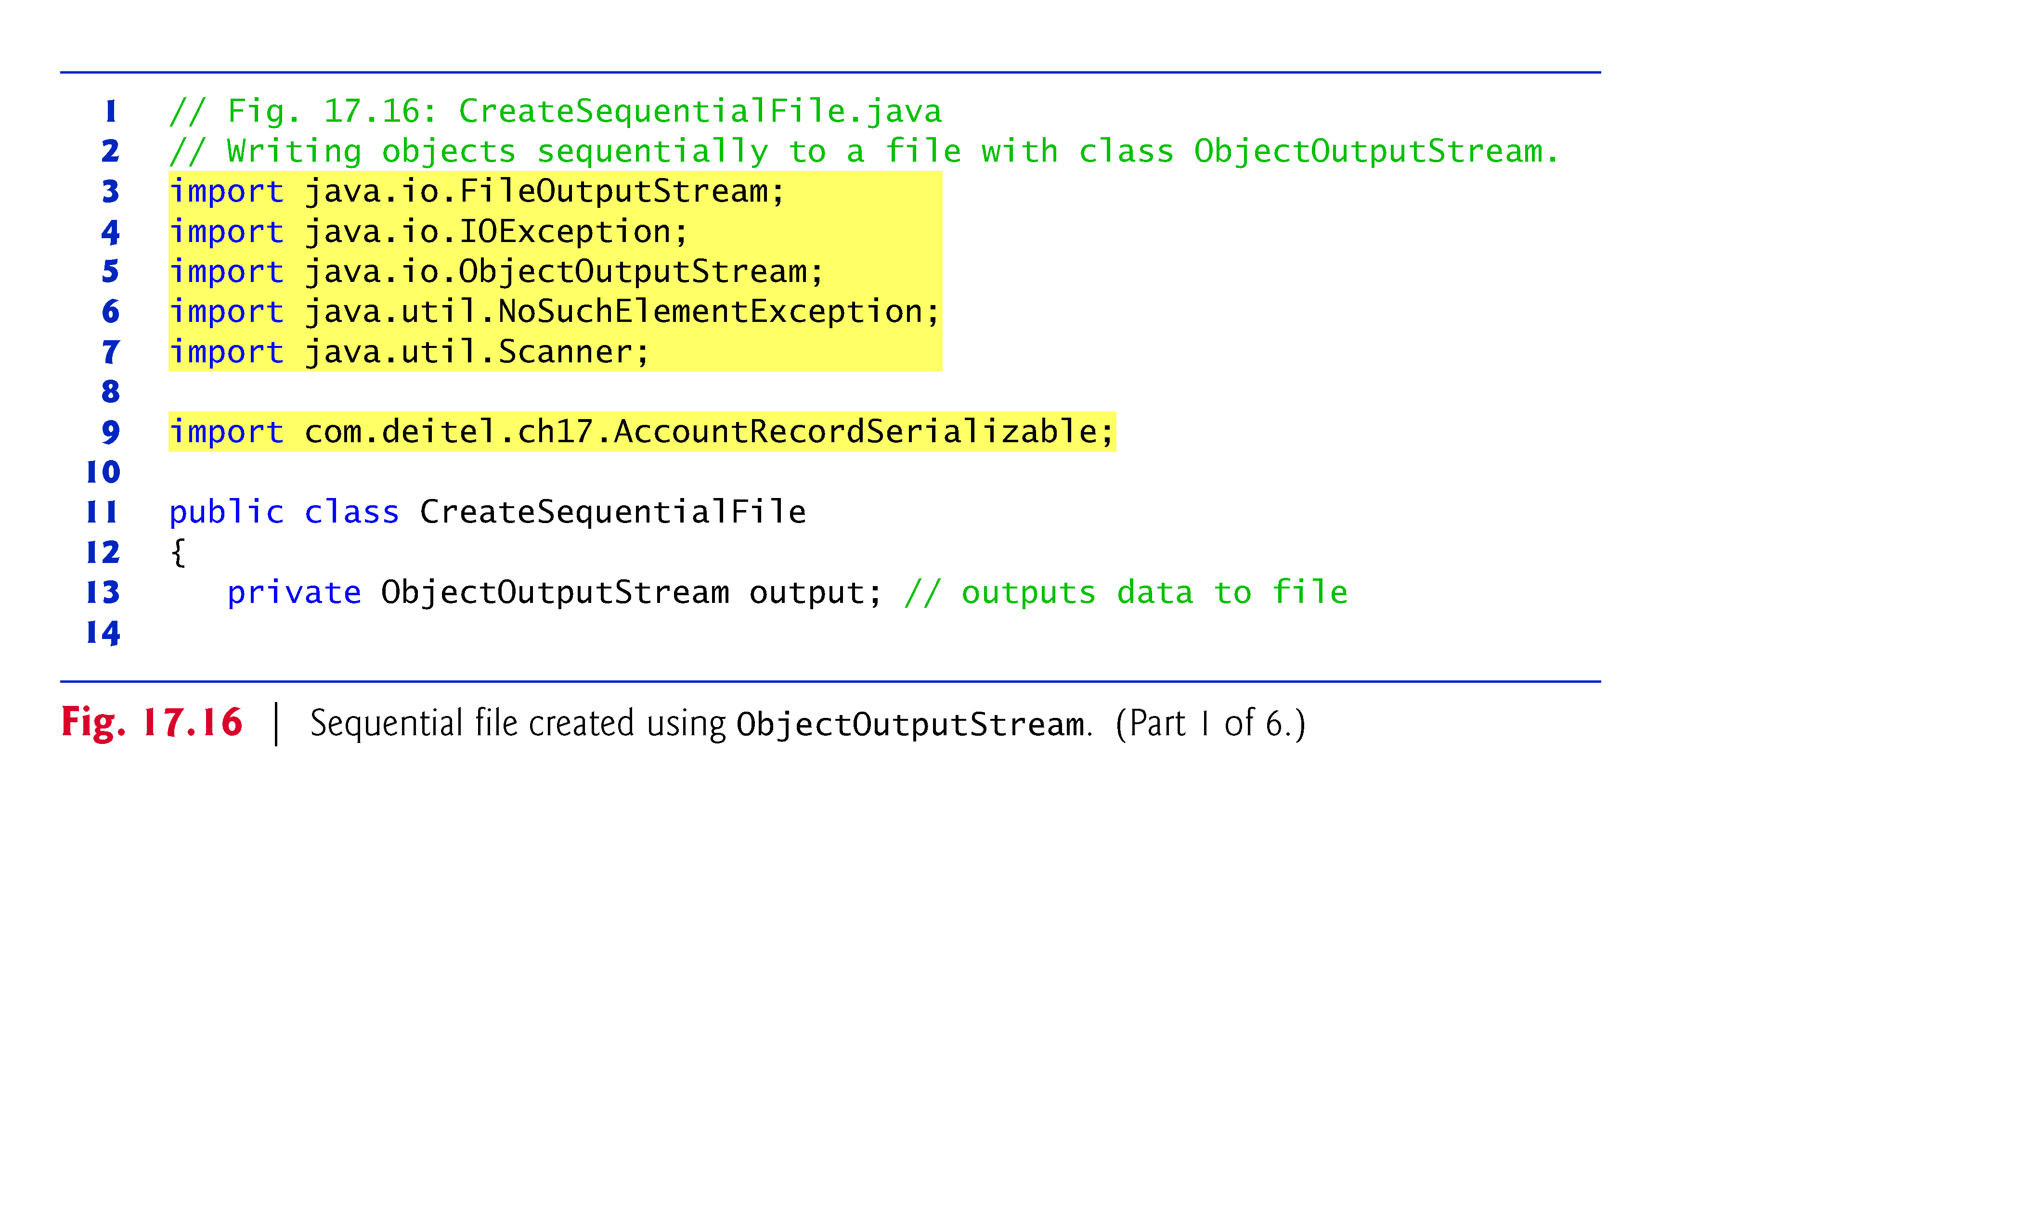

Slide 17
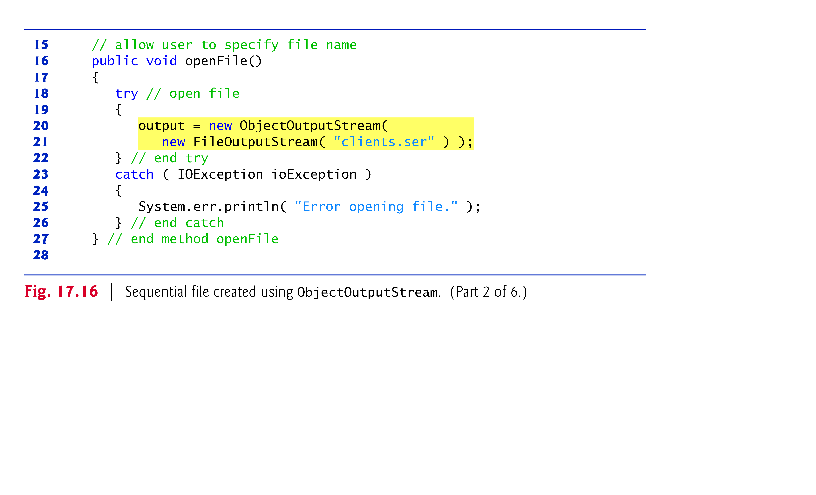

Slide 18
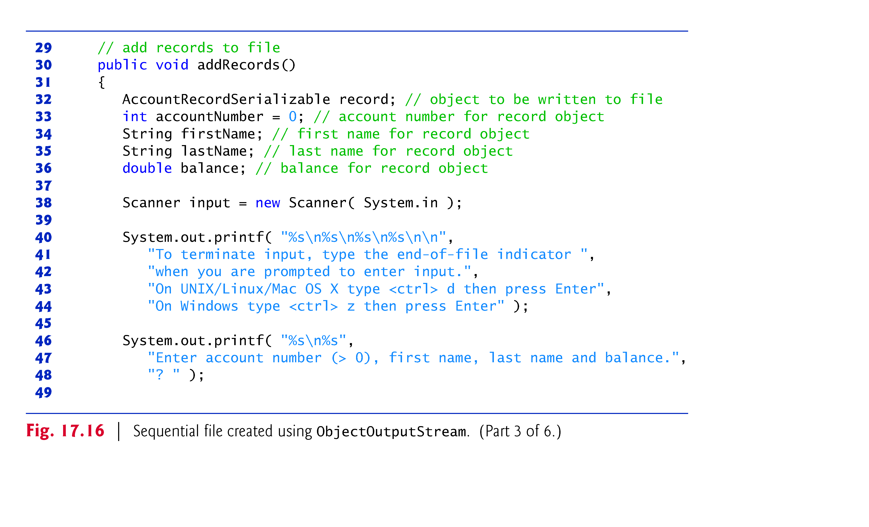

Slide 19
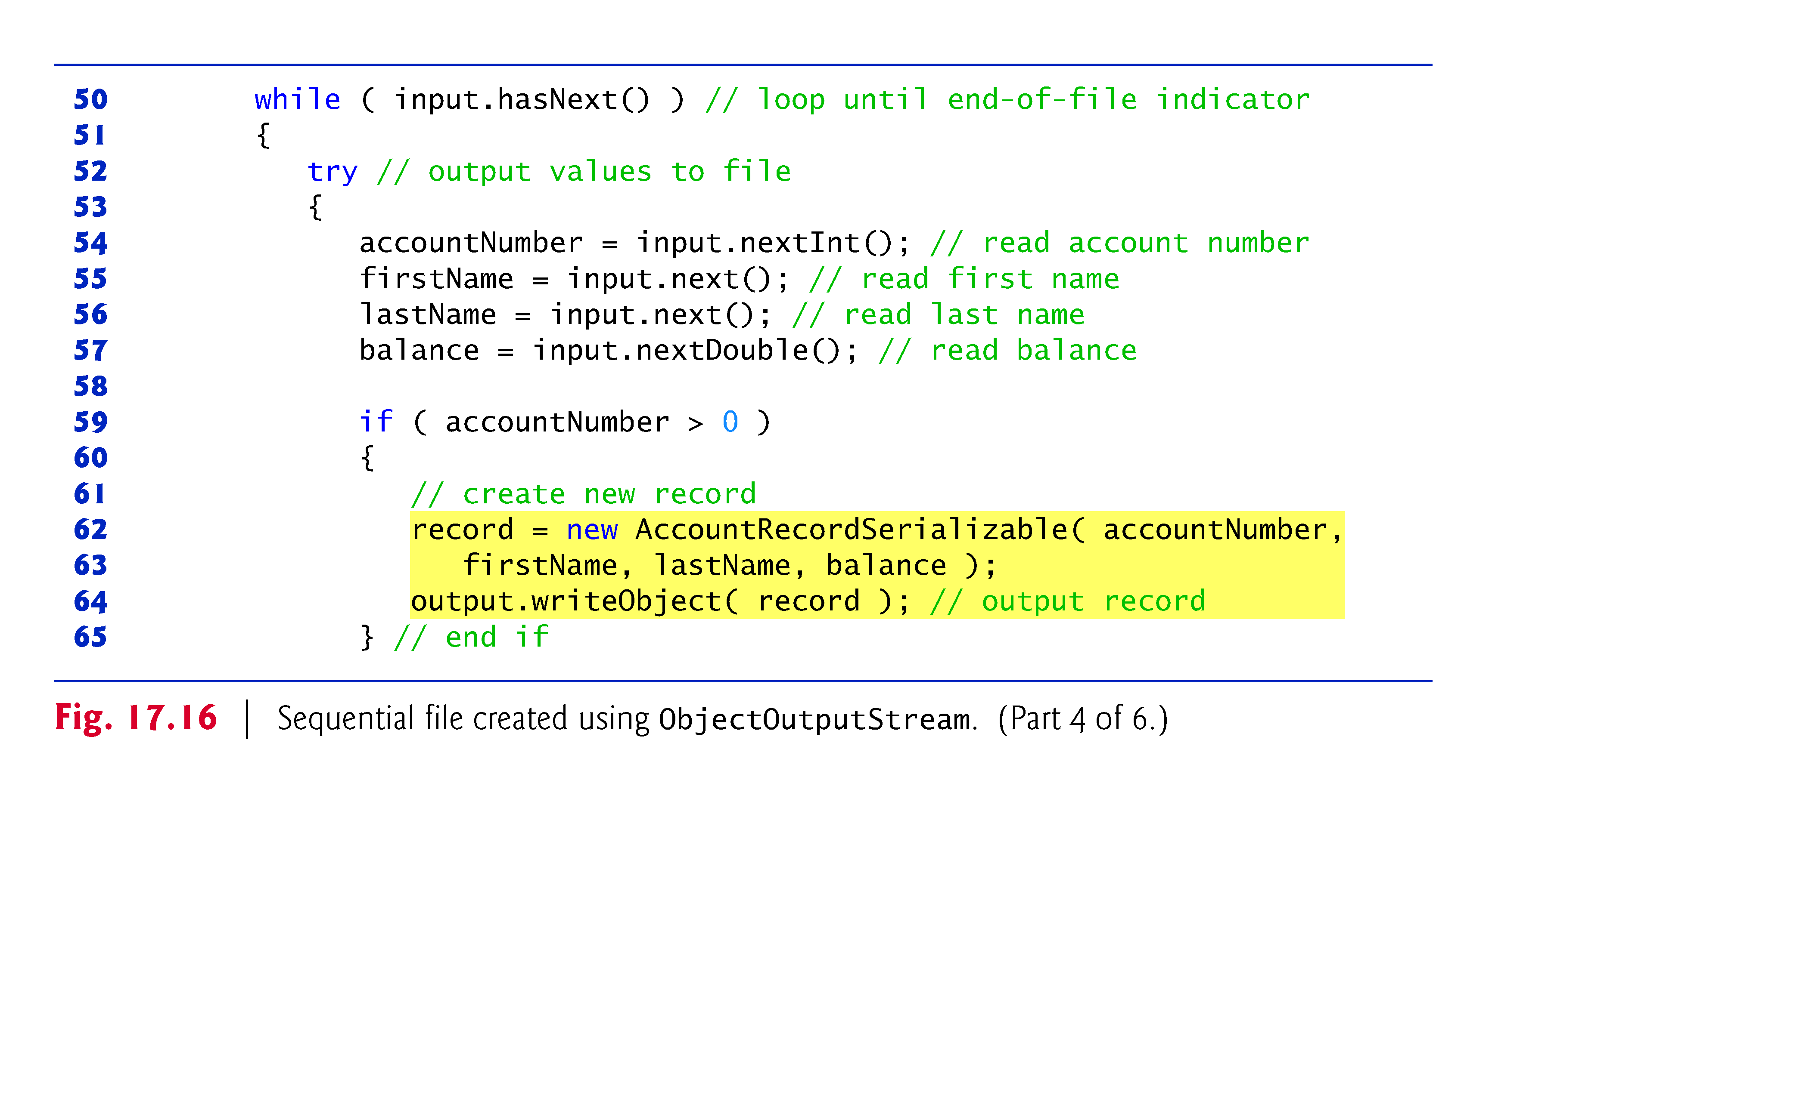

Slide 20
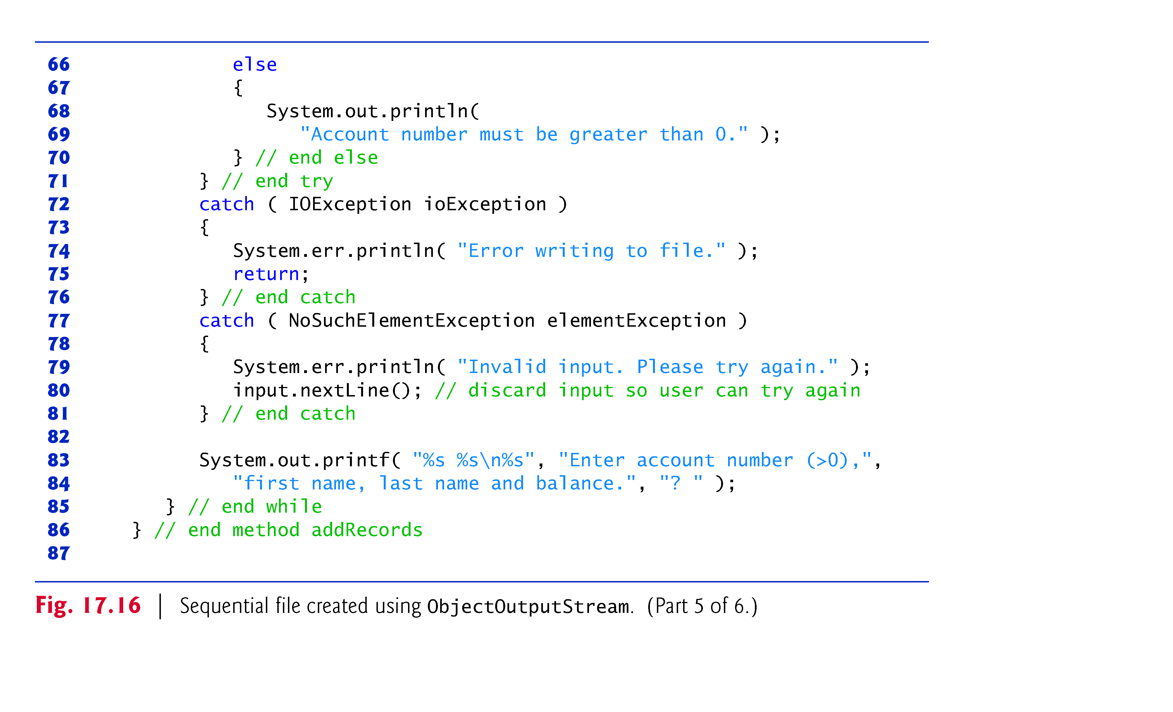

Slide 21
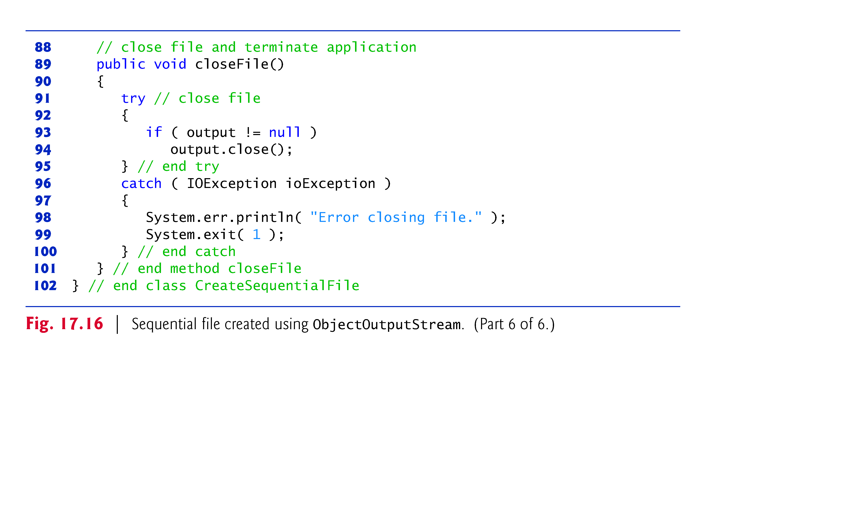

Slide 22
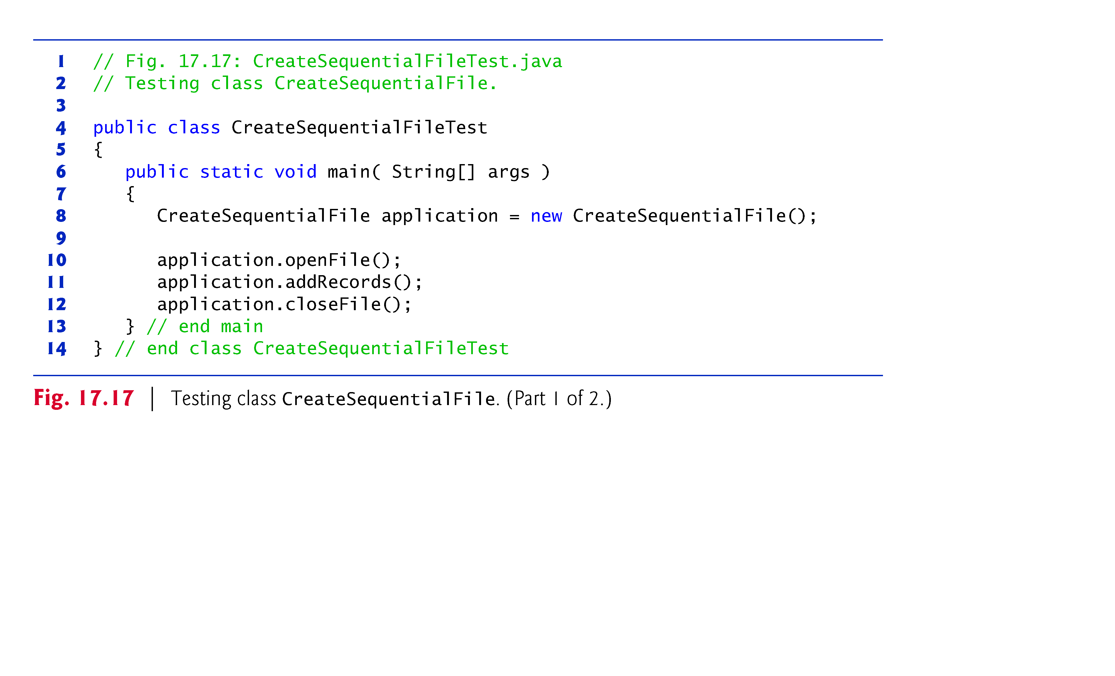

Slide 23
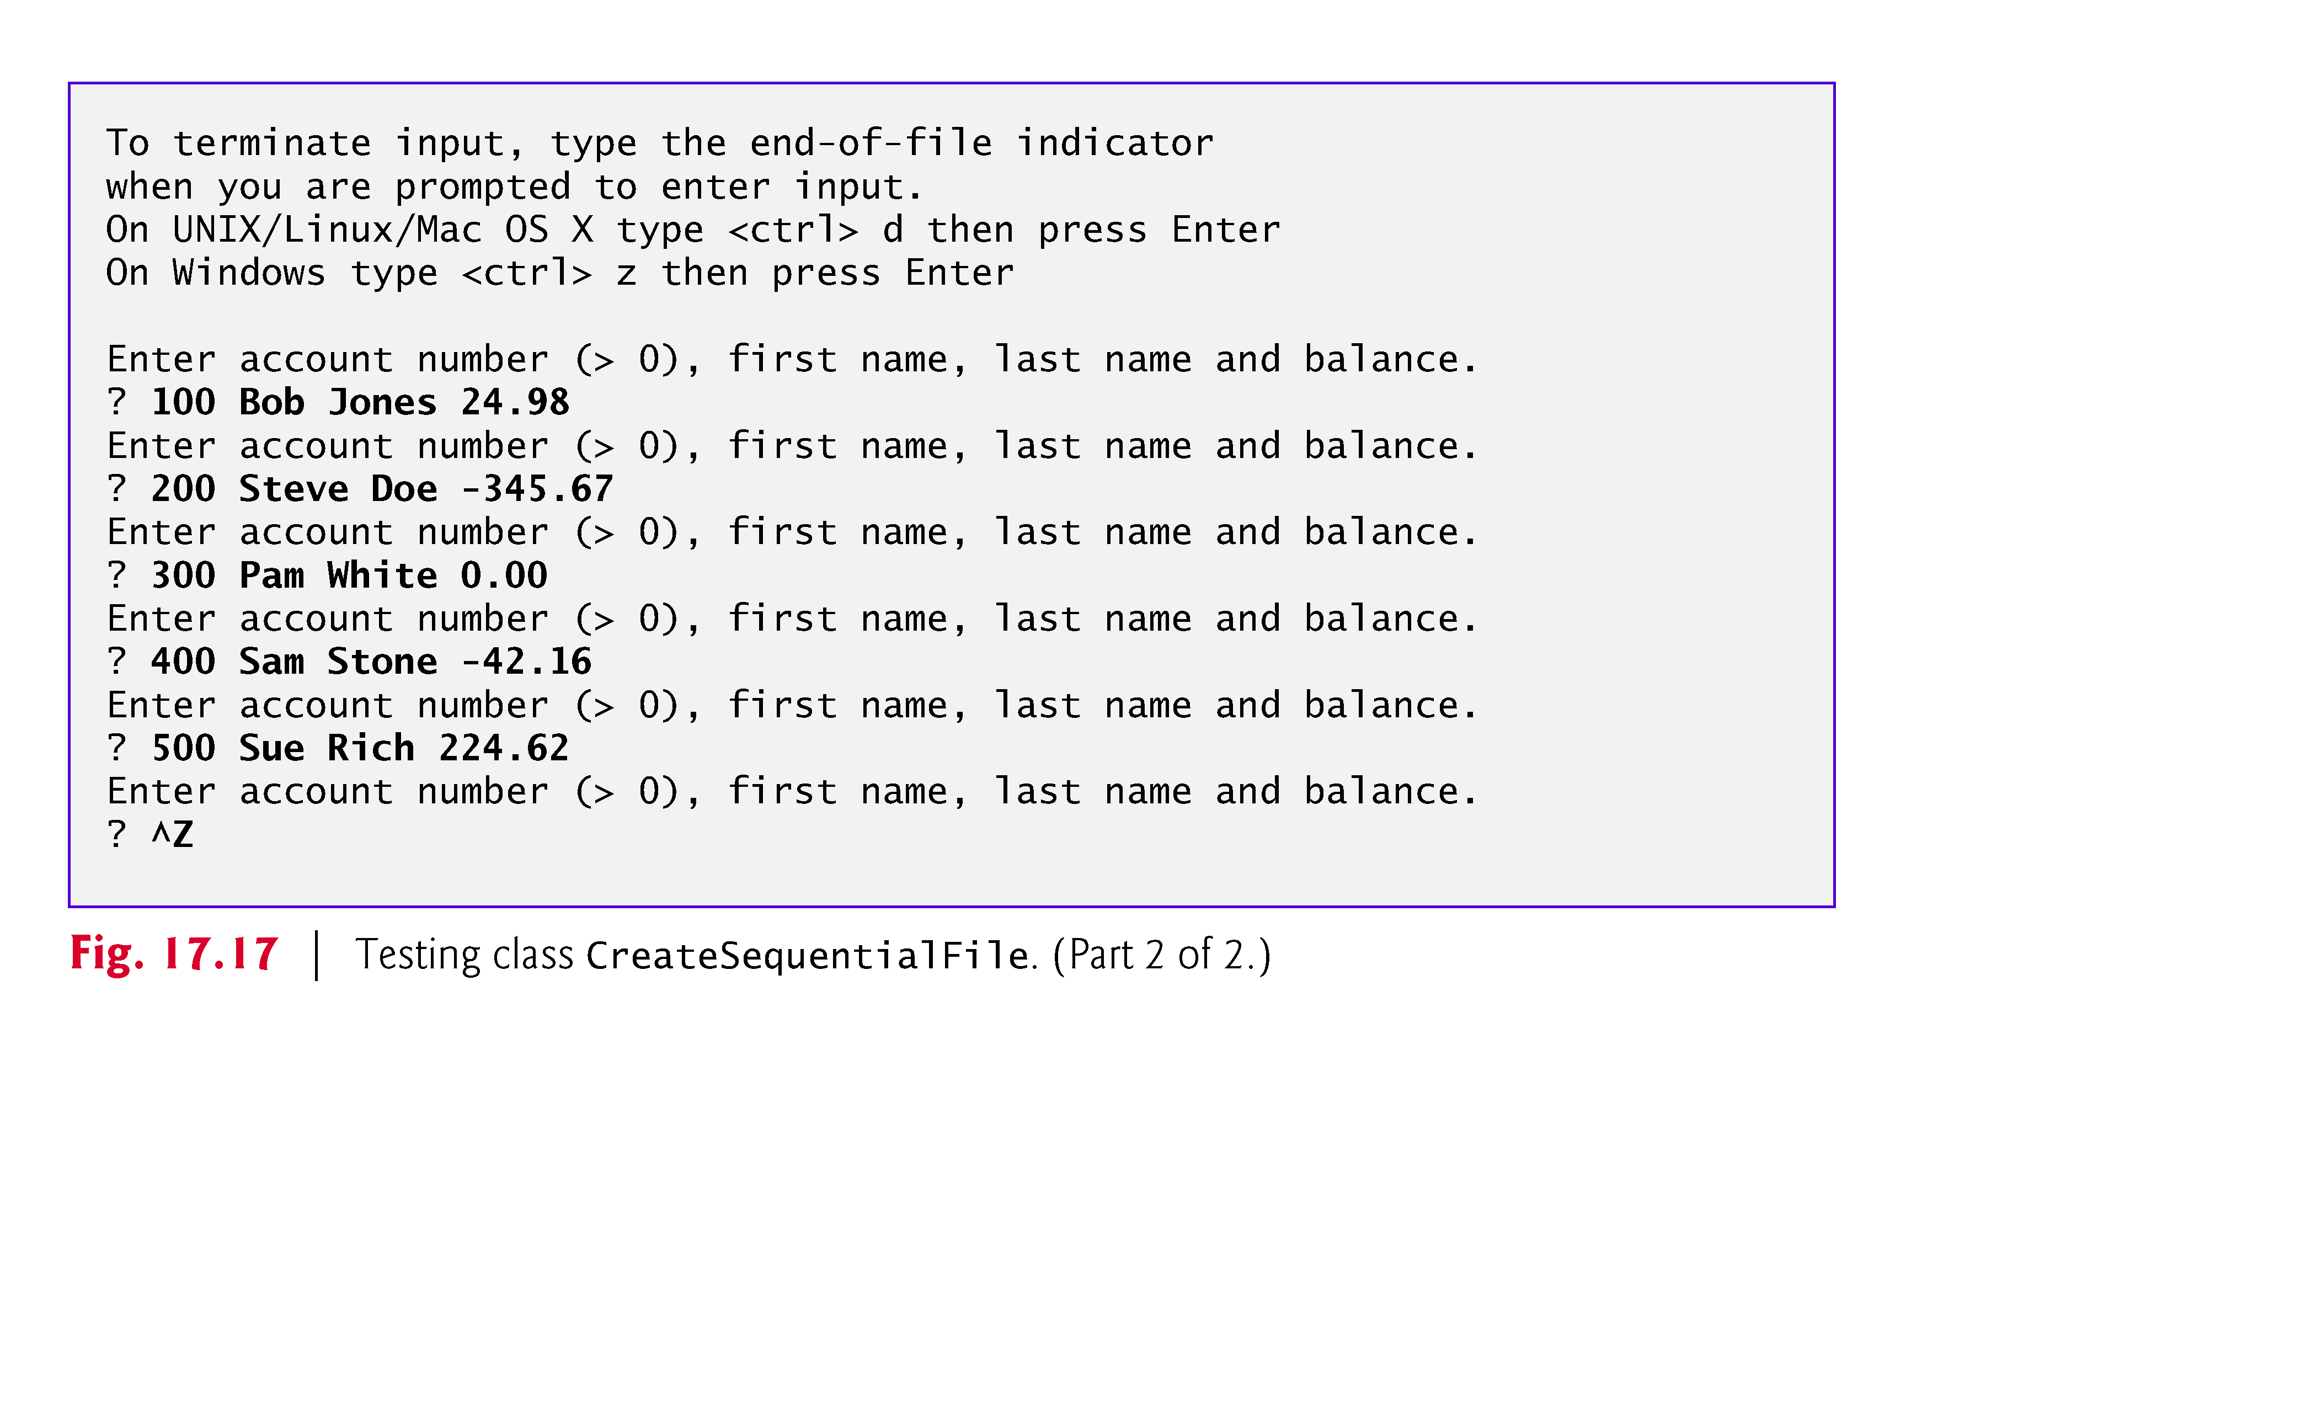

Slide 24
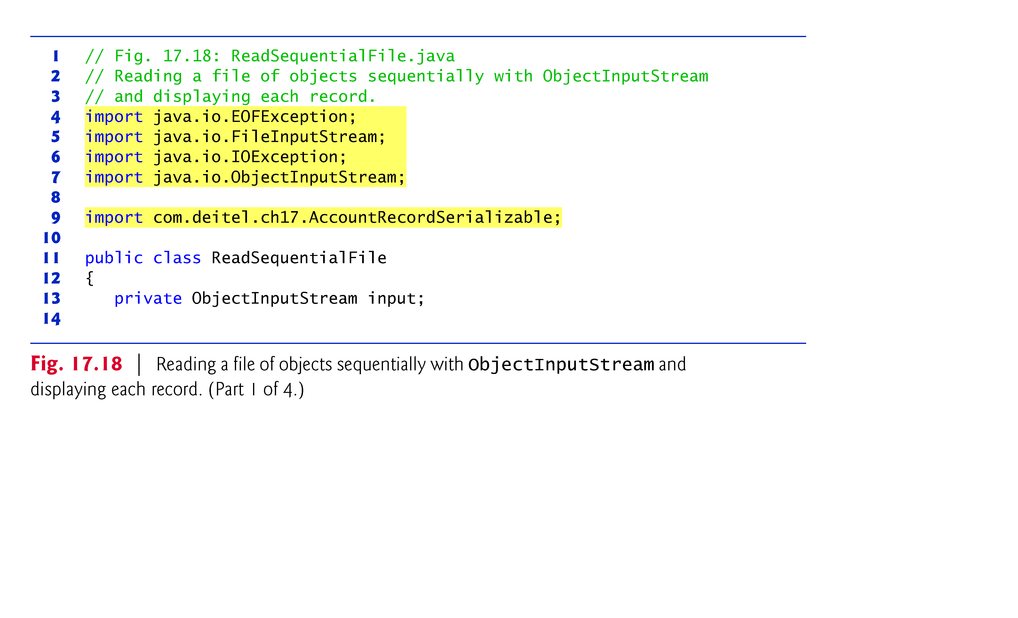
17.5.2 Reading and Deserializing Data from a Sequential-Access File

Slide 25
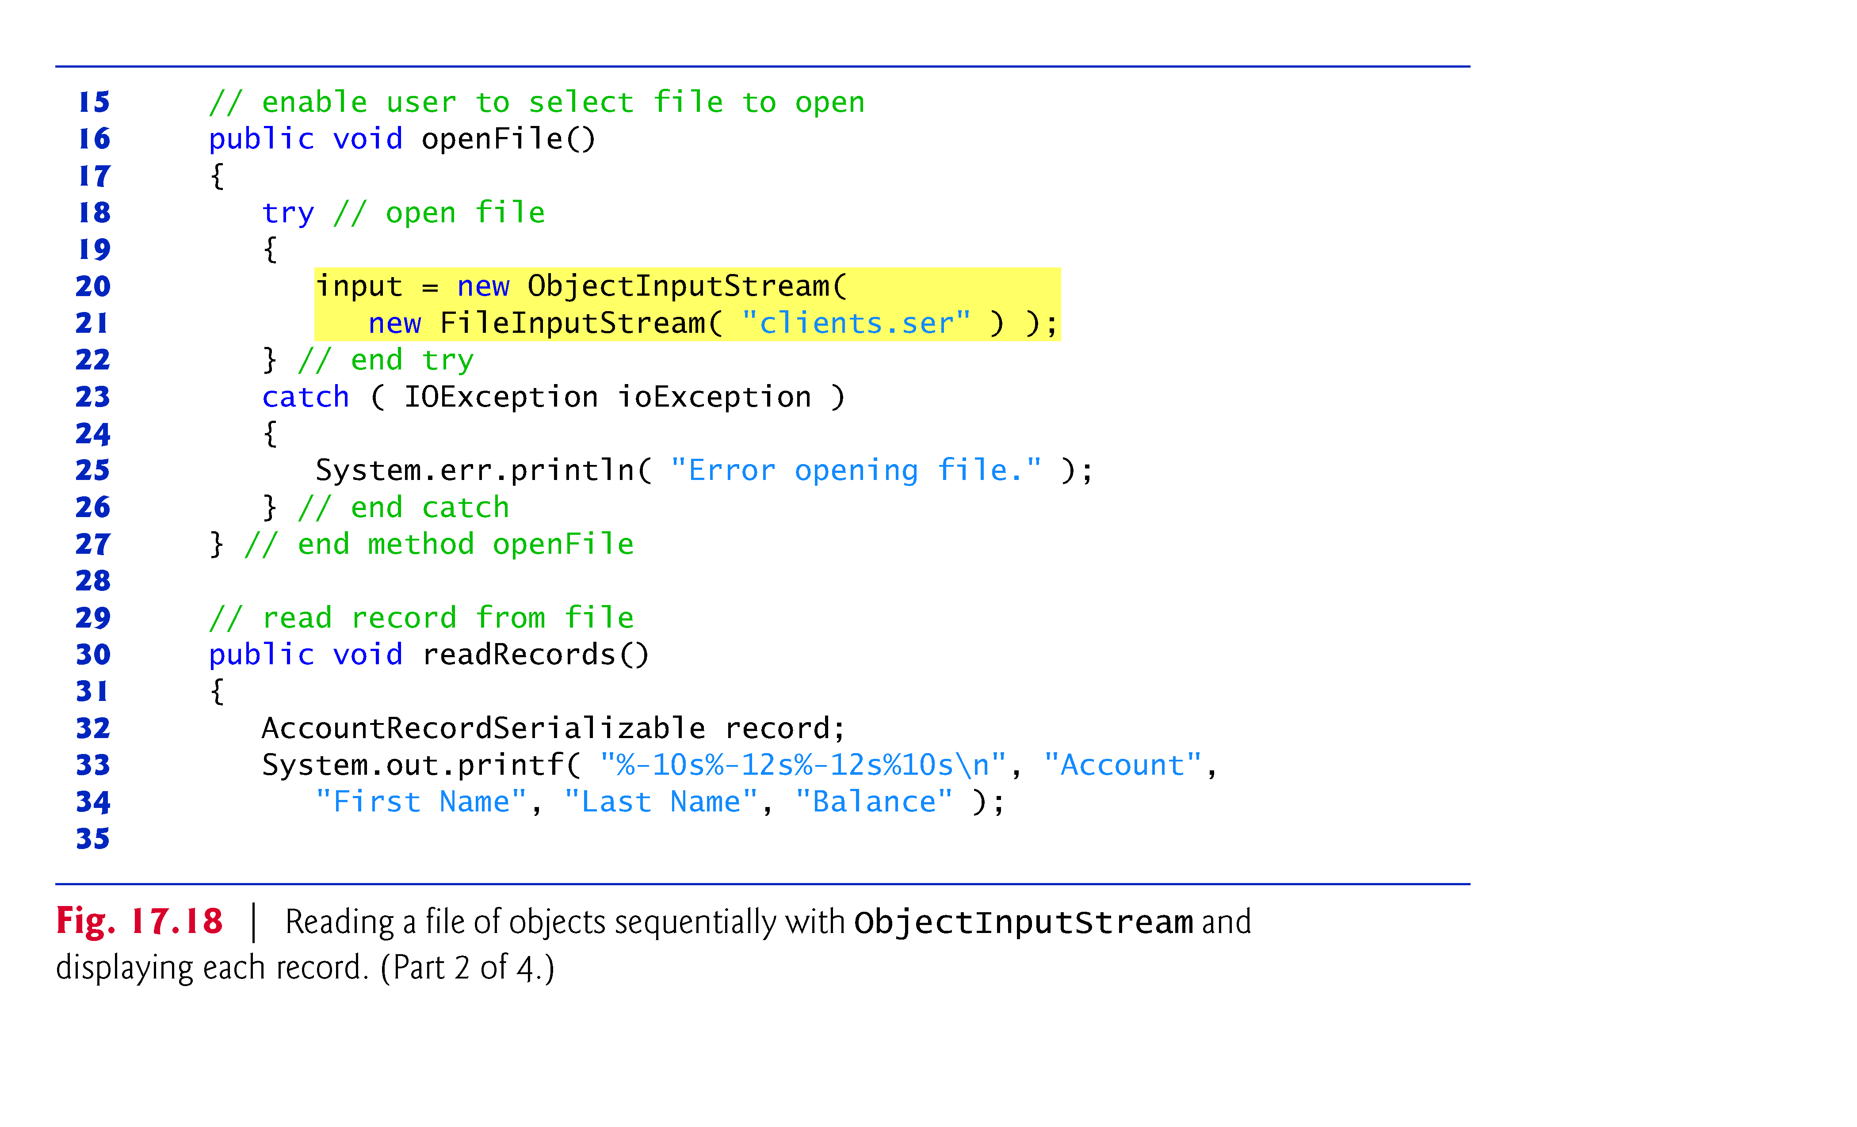

Slide 26
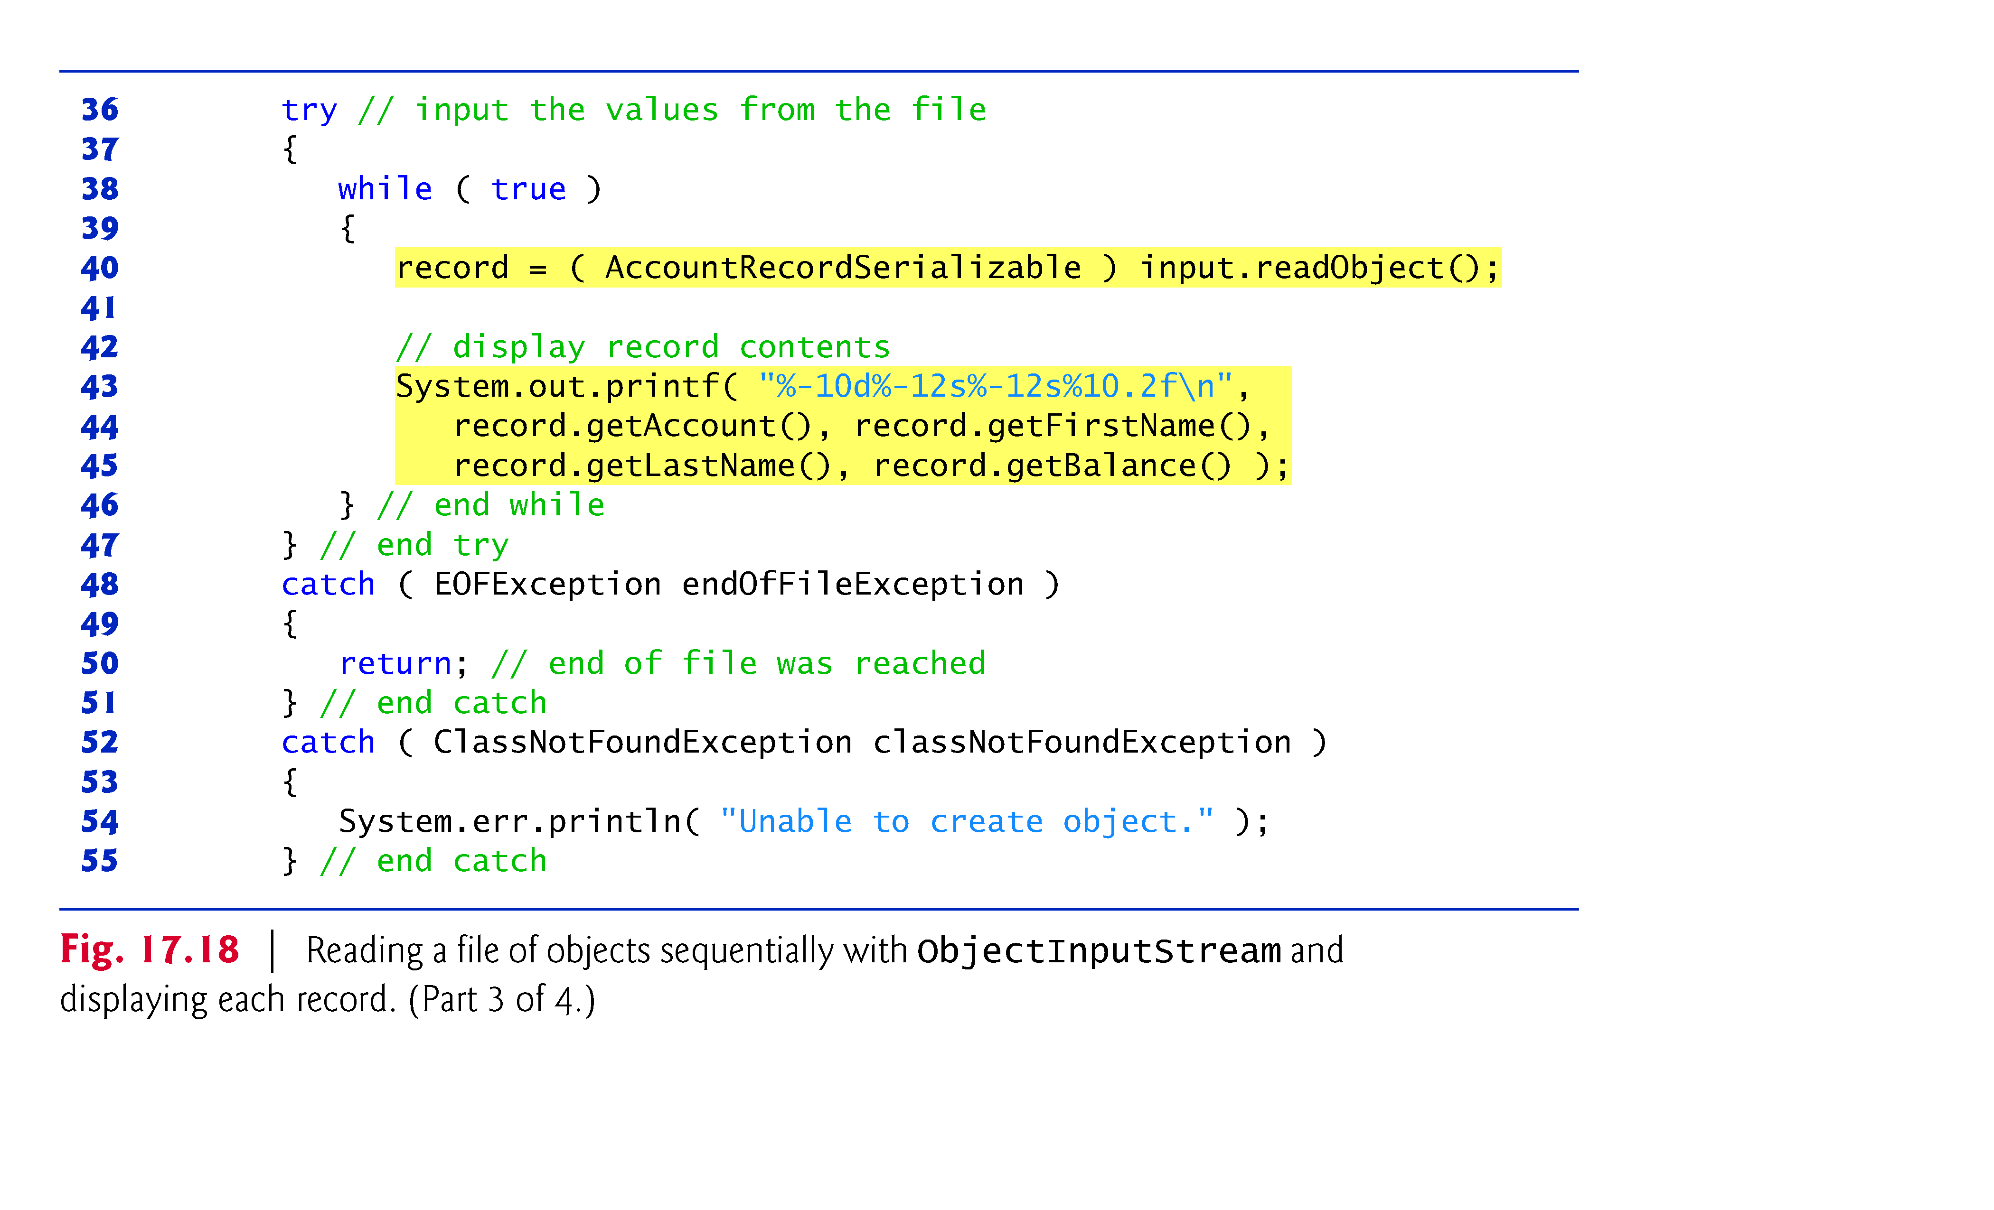

Slide 27
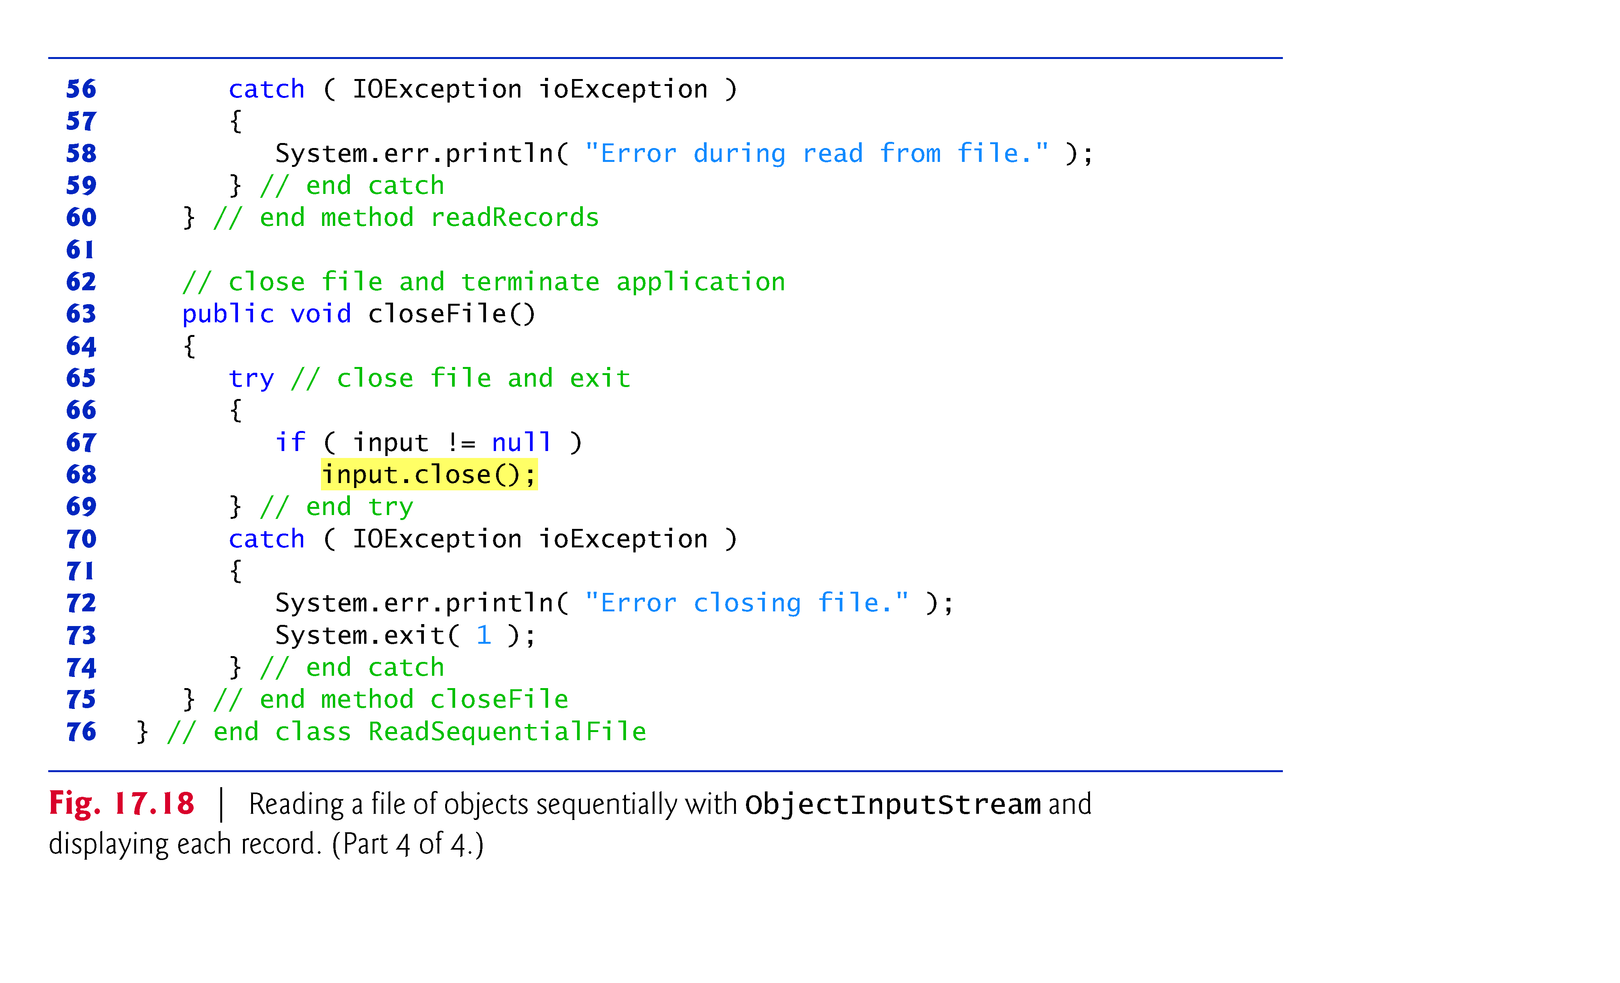

Slide 28
Reading and Deserializing Data from a Sequential-Access File (cont.)
ObjectInputStream method readObject reads an Object from a file.
Method readObject throws an EOFException if an attempt is made to read beyond the end of the file.
Method readObject throws a ClassNotFoundException if the class for the object being read cannot be located.

Slide 29
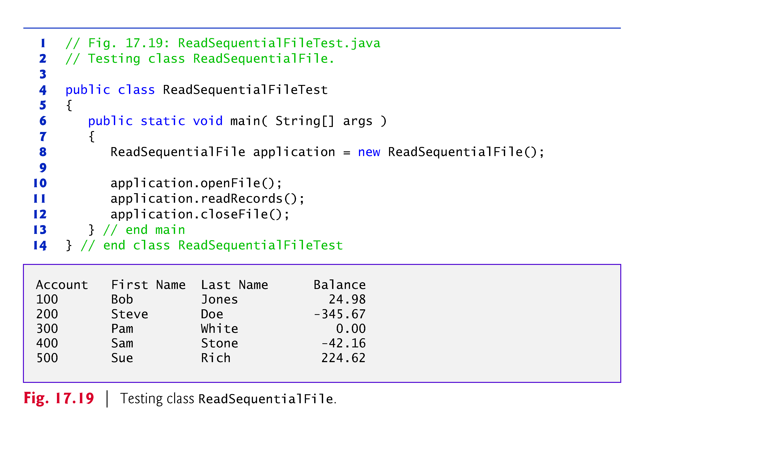

Slide 30
Appending to an Existing File
output = new ObjectOutputStream( new FileOutputStream( "clients.ser",true ) );

Slide 31
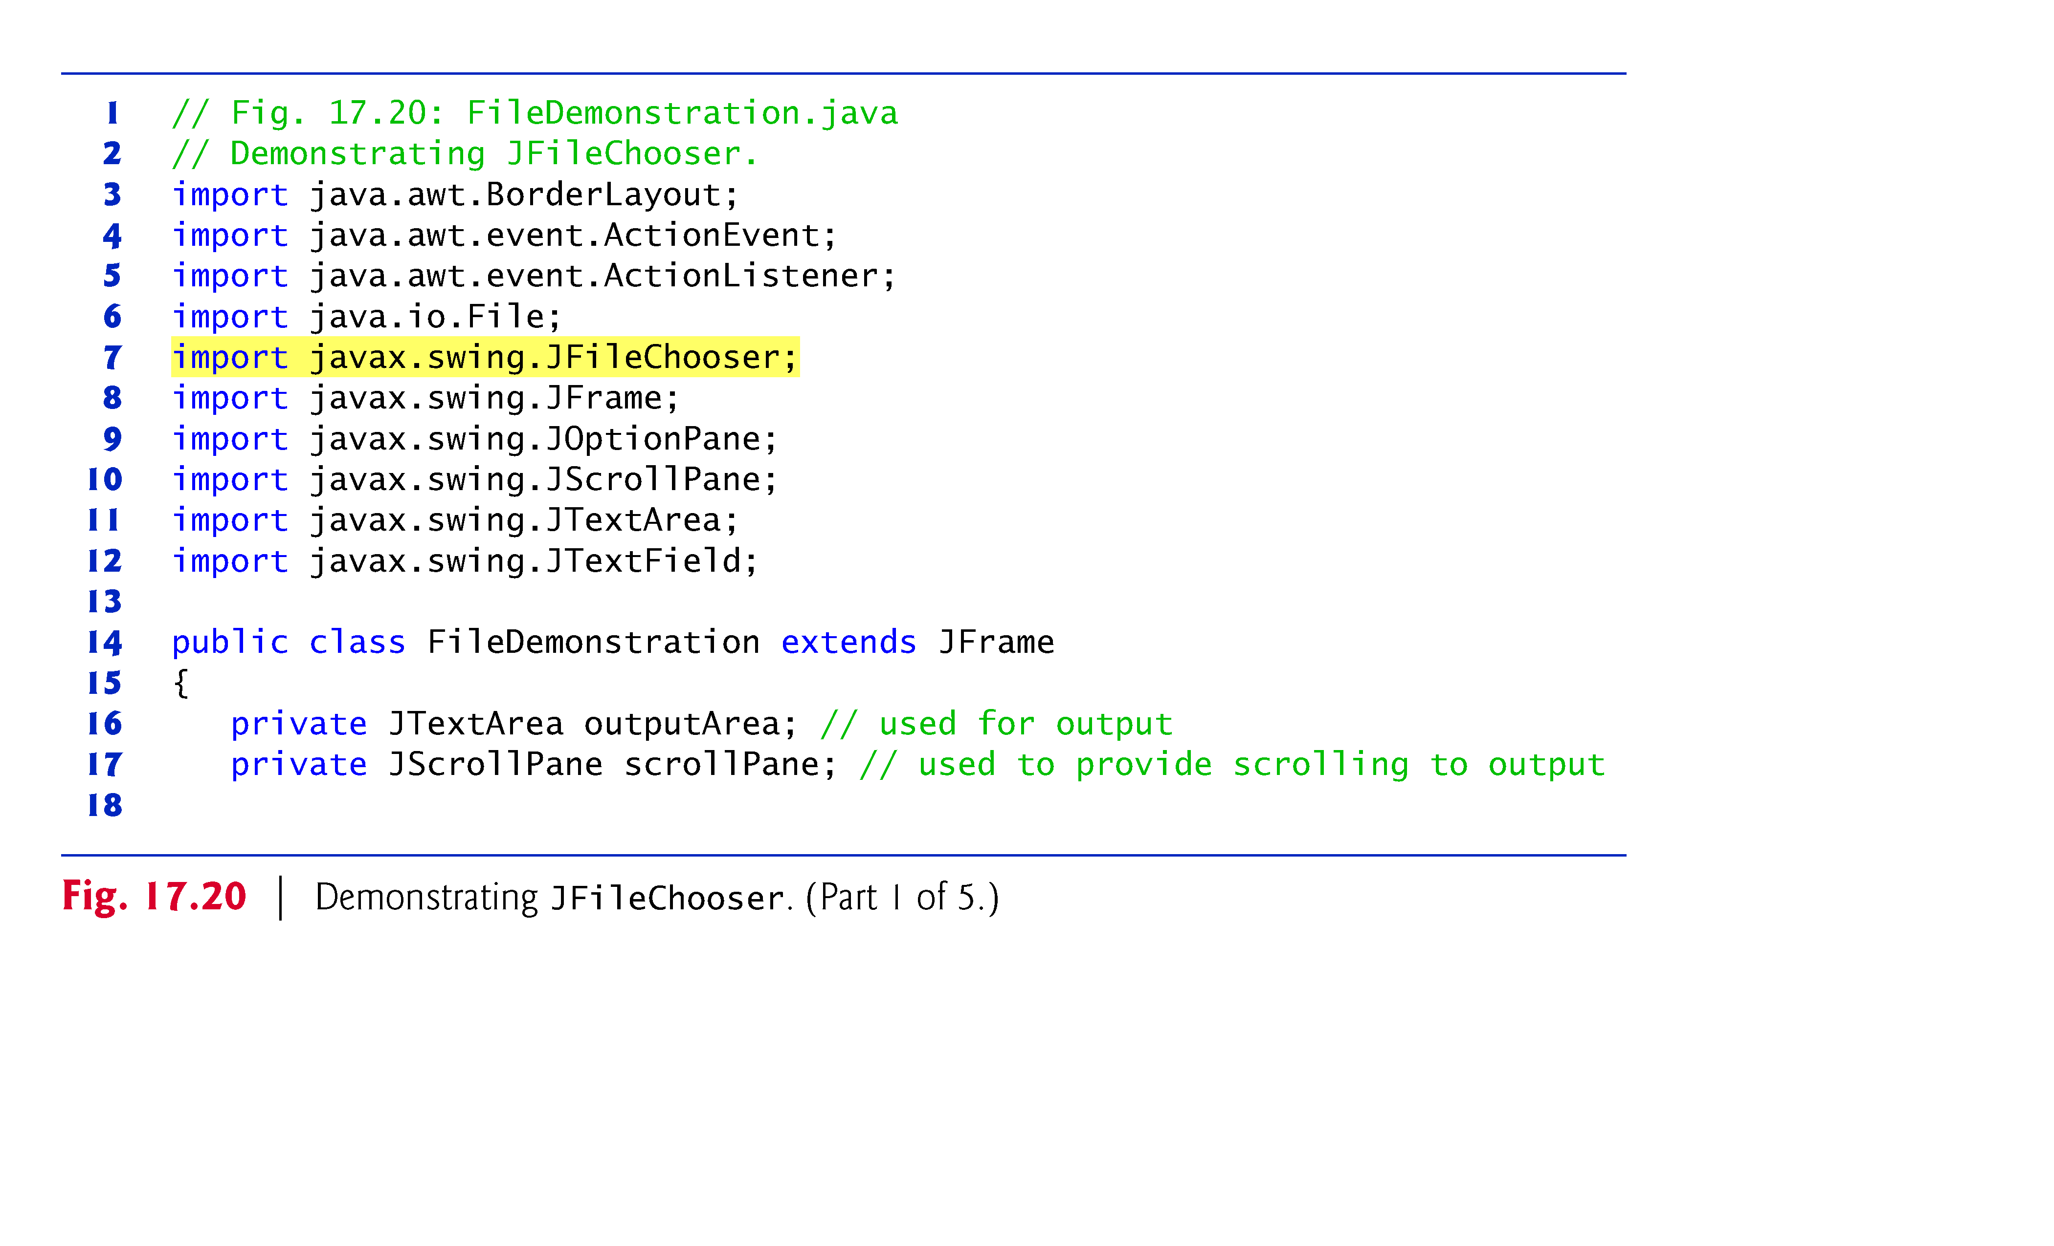

Slide 32
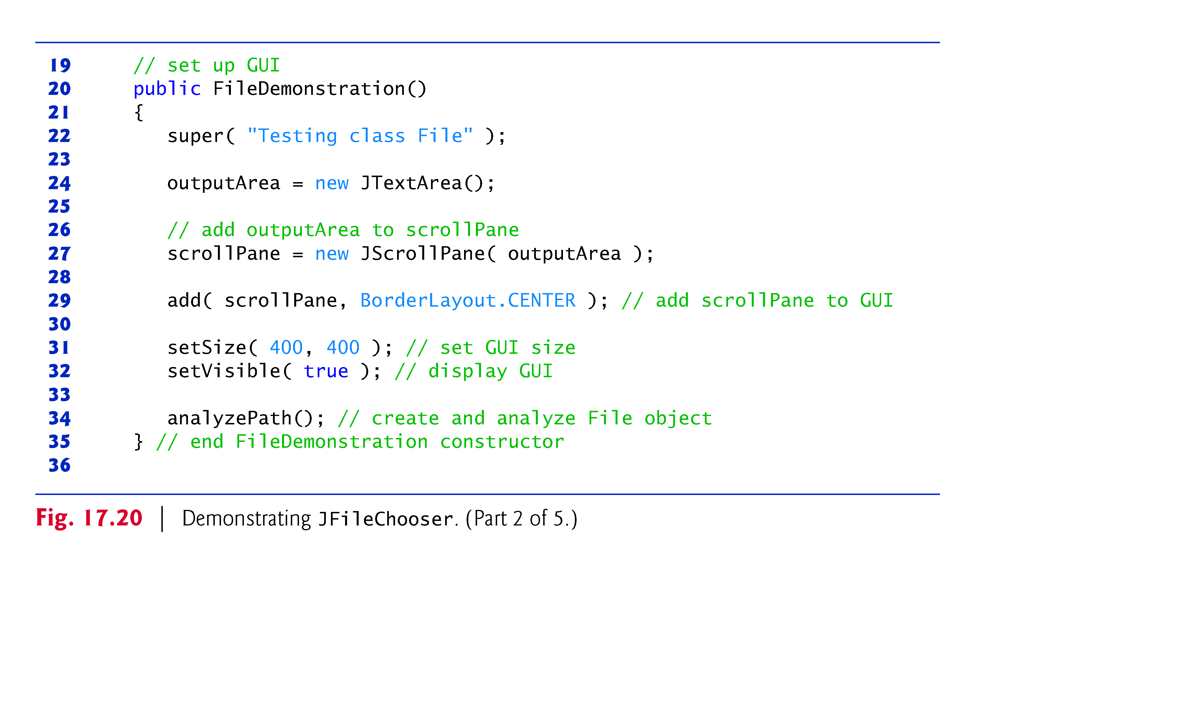

Slide 33
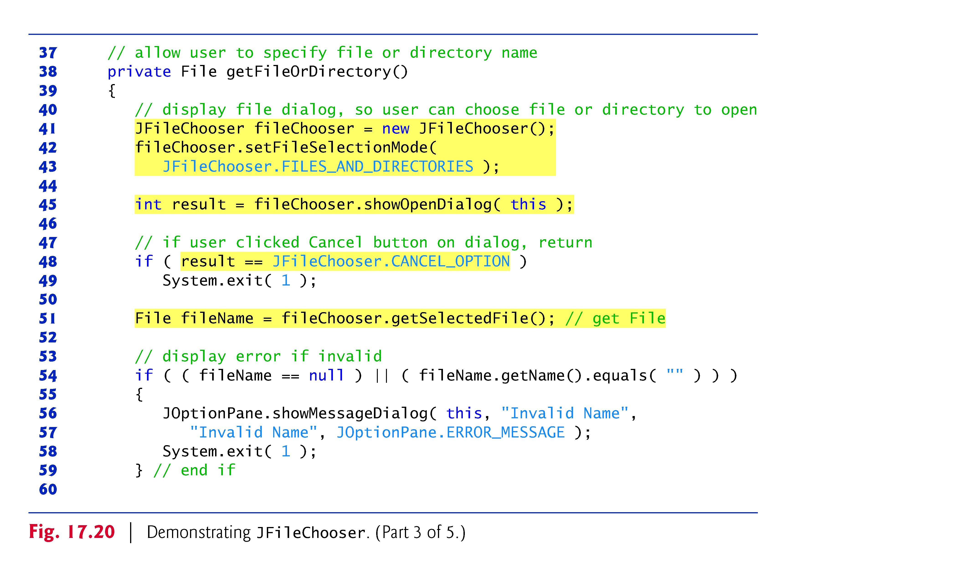

Slide 34
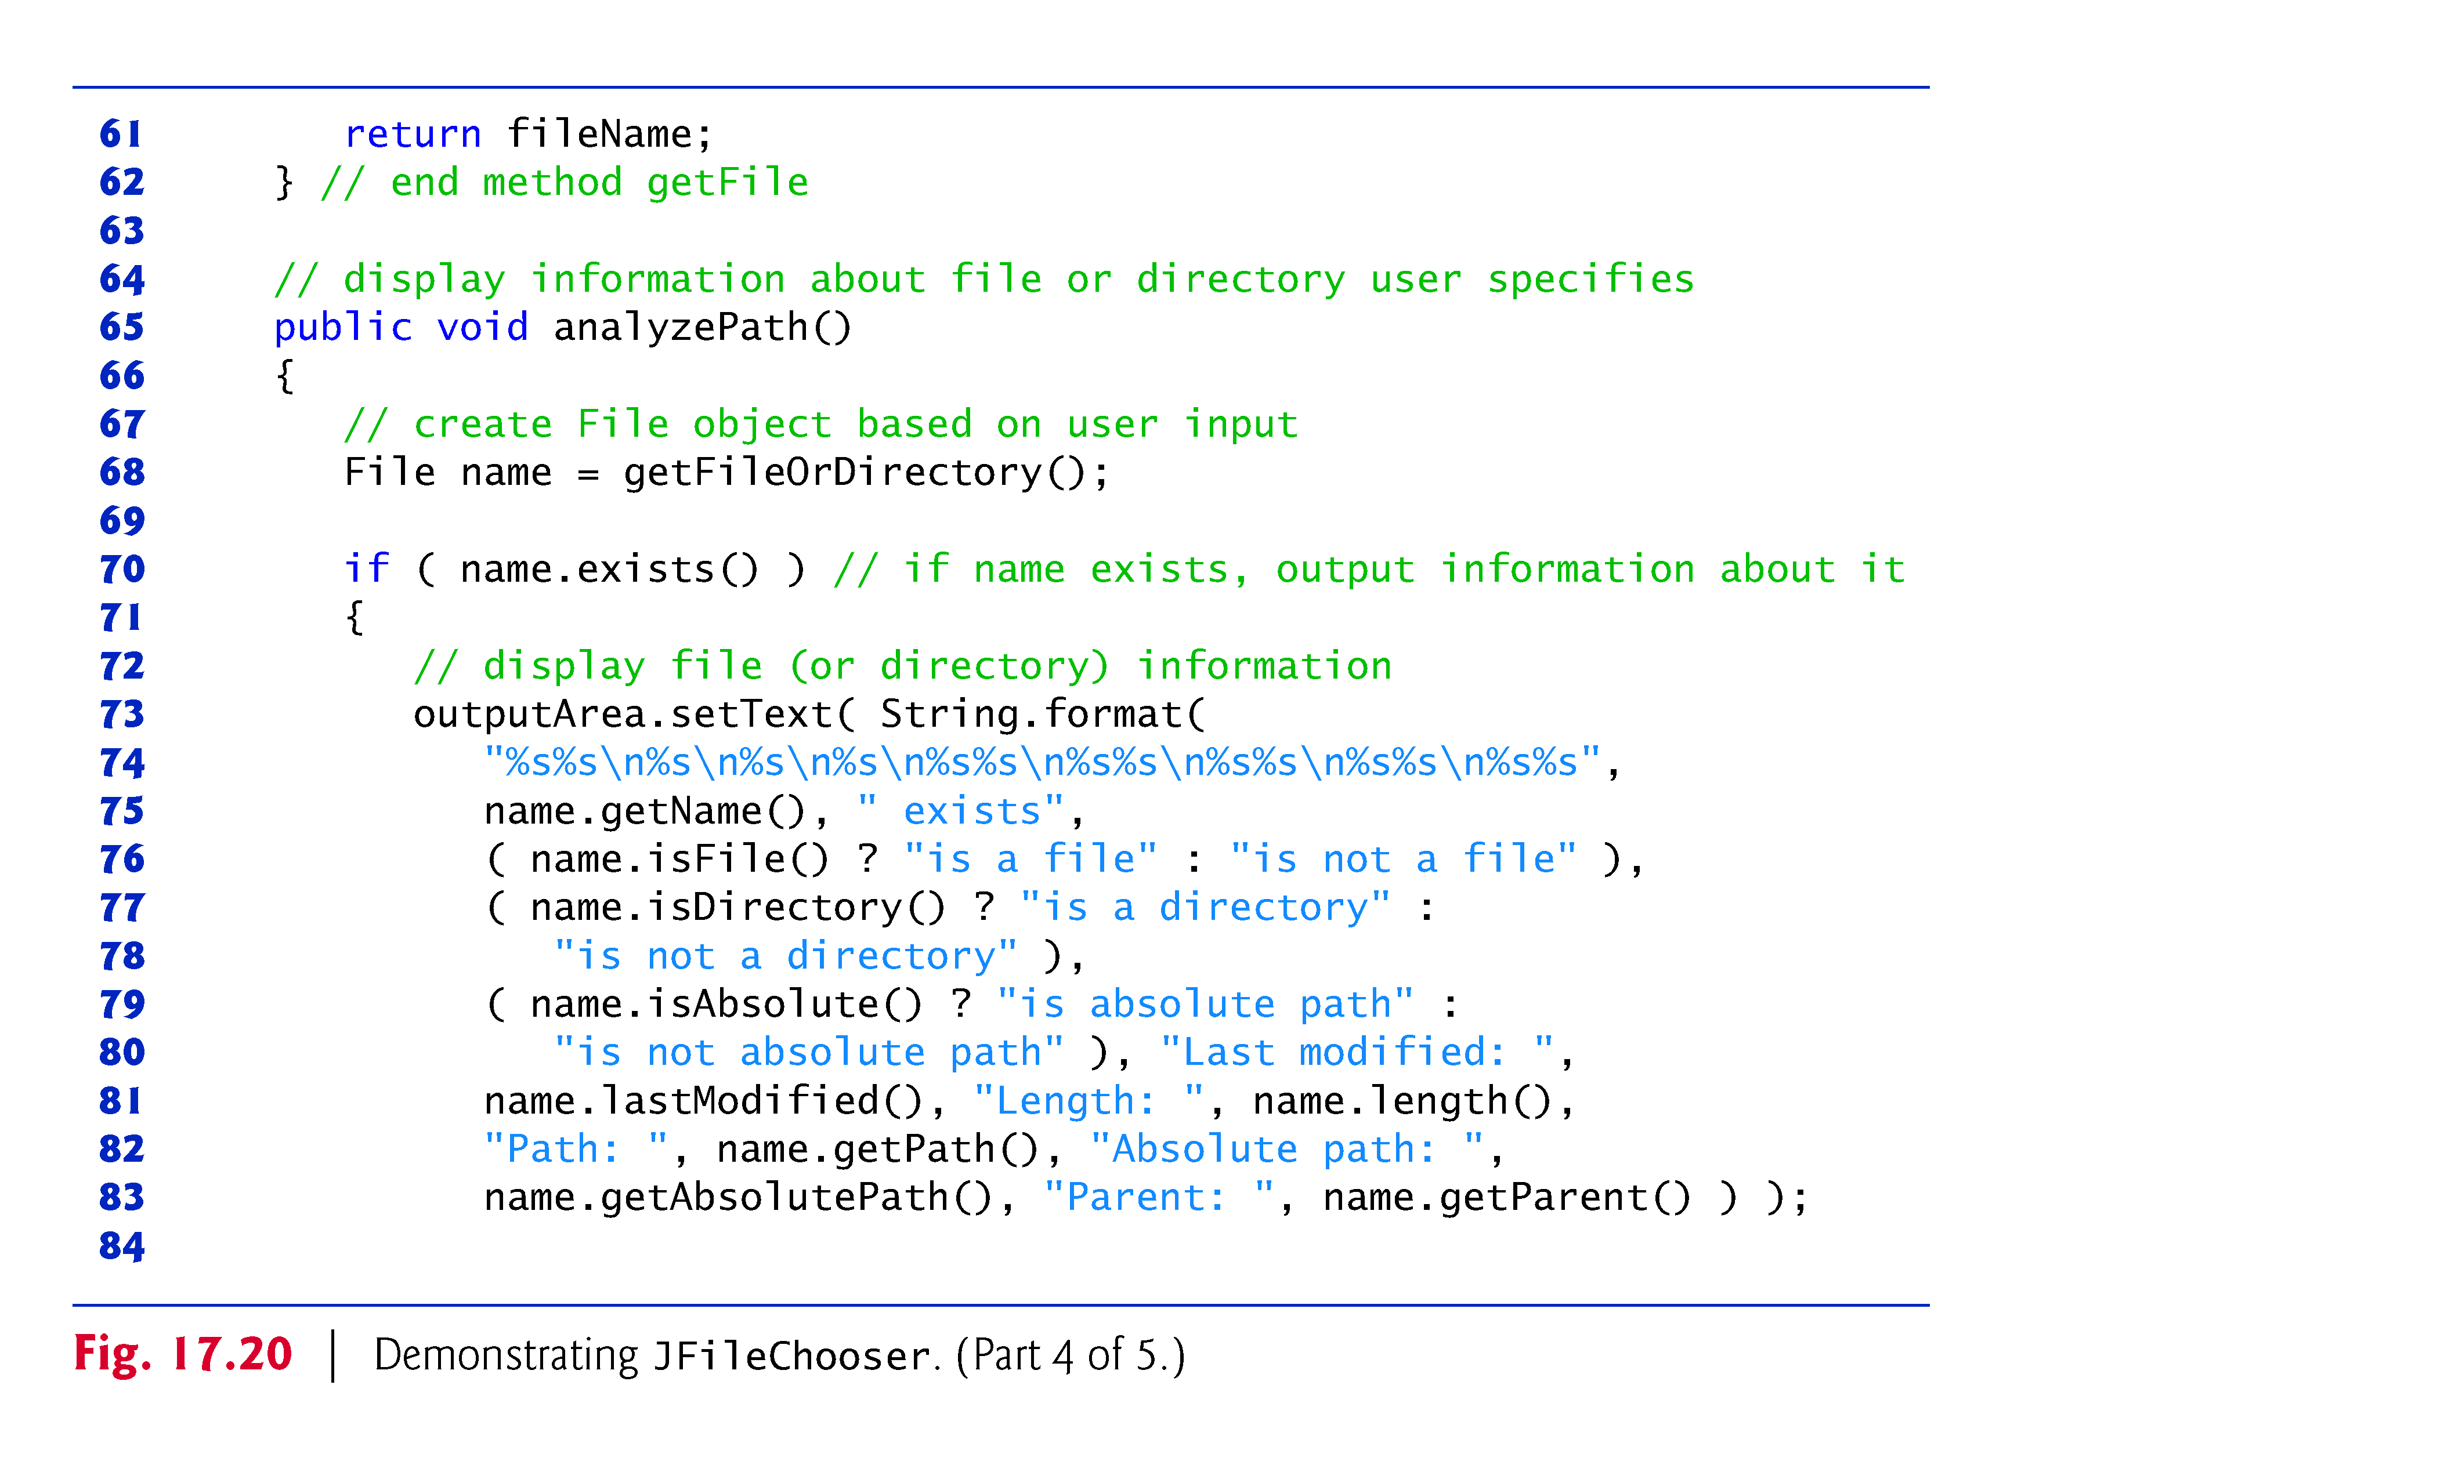

Slide 35
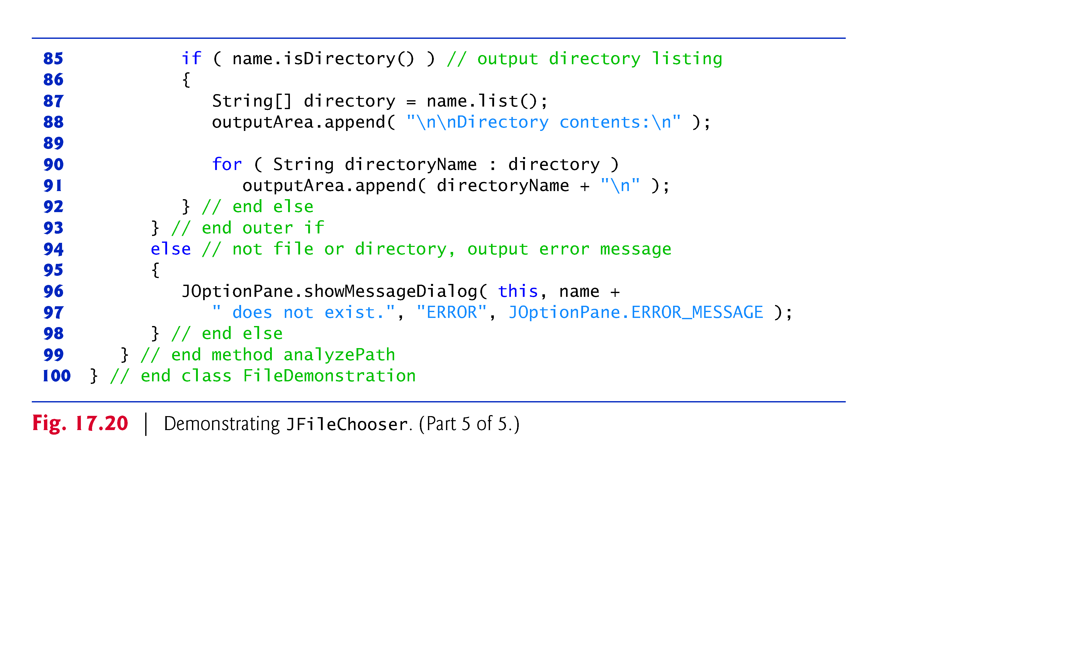

Slide 36
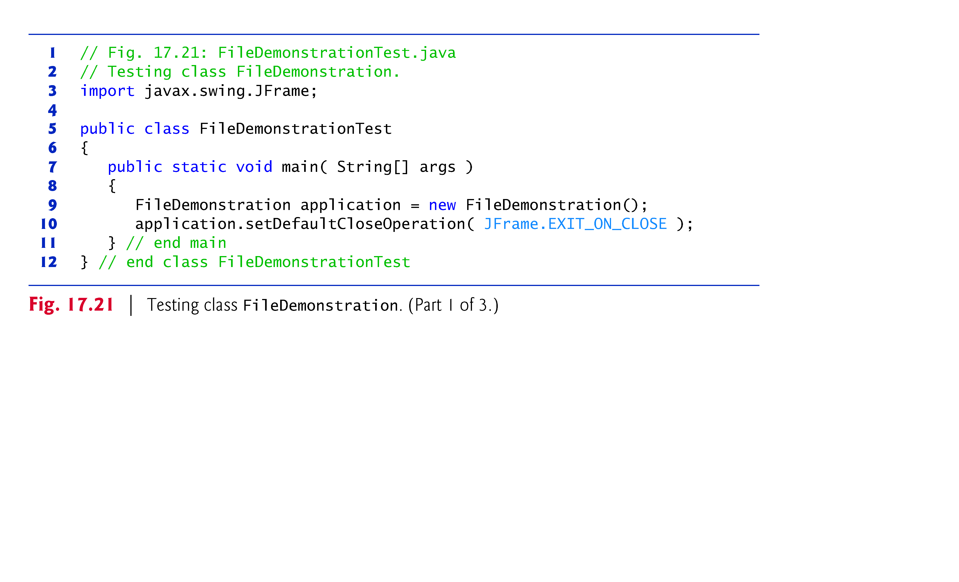

Slide 37
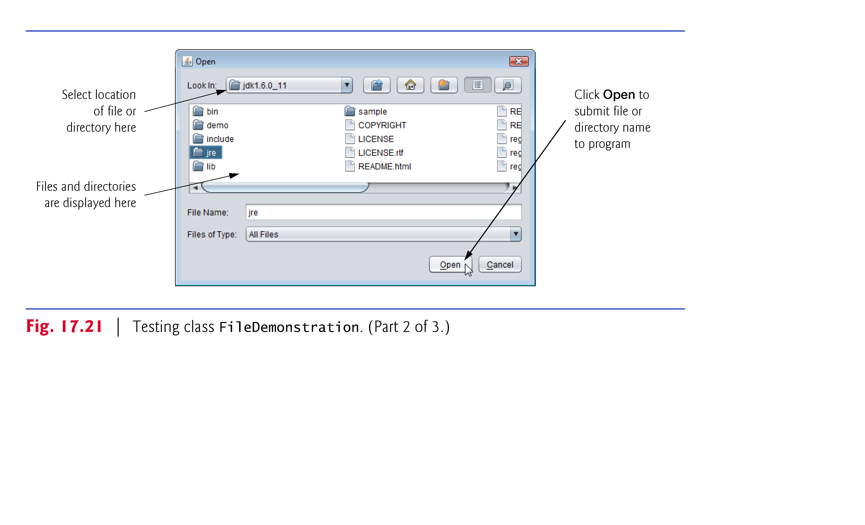

Slide 38
